Slide 1
NerG
(Progress Update)
Team: | Abhilash Kashyap Balasubramanyam Adnan Patel
Instructor: | Dr. Jafar Saniie
ECE 510 Summer 2024 Date: 05th June 2024

Slide 2
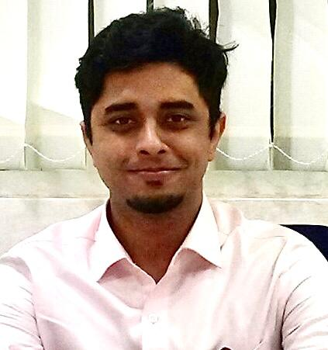

The Team
Abhilash Kashyap
Balasubramanyam
Master of Engineering
in Artificial Intelligence for
Computer Vision and Control
Adnan Patel
M.S. Electrical Engineering
Focus in VLSI construct and circuit building.

Slide 3
Summary
Harness underutilized energy from everyday surroundings to create a substantial impact on Smart Energy grids in Smart Cities or Smart Ecosystems by combining numerous small energy harvesting efforts.
In its alpha stage, the project focuses on solidifying the core concept of energy harvesting through unconventional means, emphasizing a minimalist and robust foundation.
Demonstrate the concept by converting harvested energy to power a lighting system or charge electronic devices, showcasing practical applications of the harvested energy.
Contribute significantly to a Smart Energy grid, integrating multiple small-scale energy harvesting modules into a larger, efficient, and sustainable energy network.

Slide 4
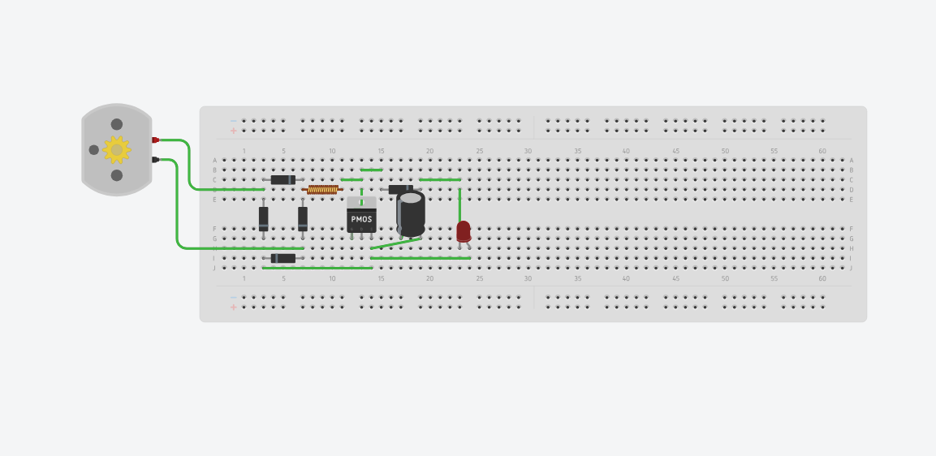
Technical Specifications

Slide 5
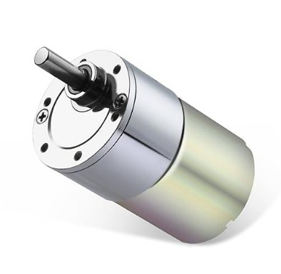
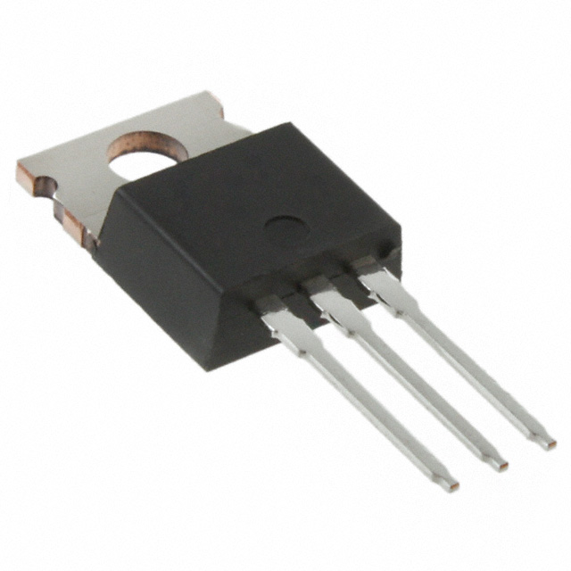
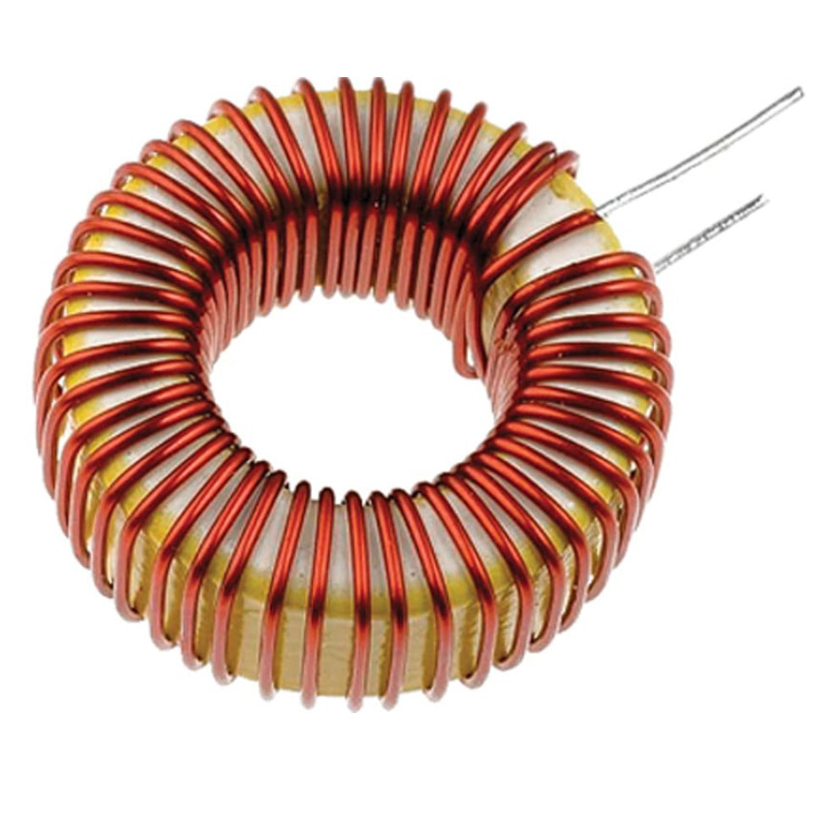
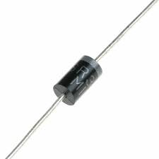
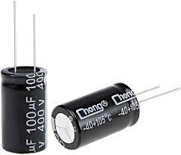
Hardware Description
Generator- 24vdc 20 rpm gearhead motor
MOSFET (IRL530)
Inductor (400uH)
Diode (1N5819)
Capacitor (1000uF)

Slide 6
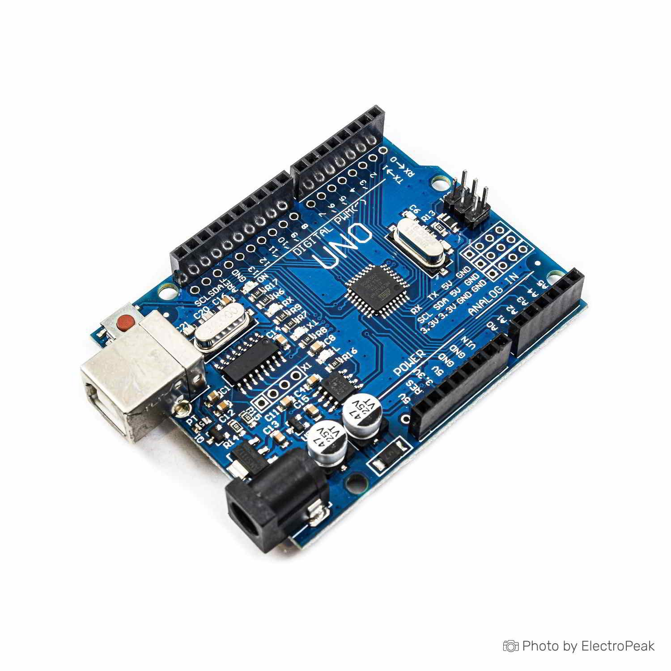
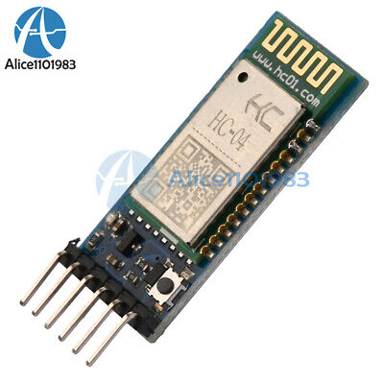
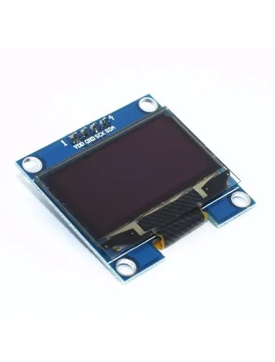
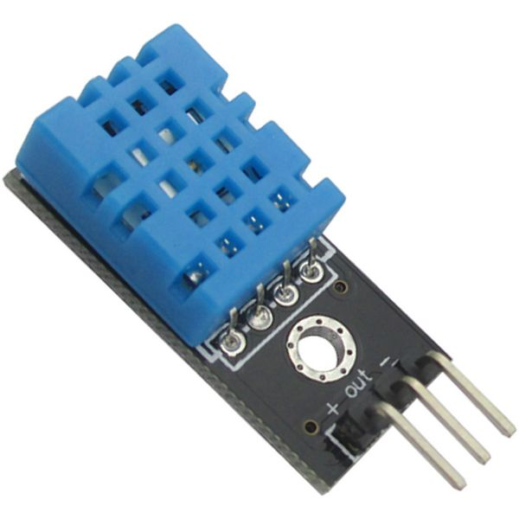
Software Description
HC-05 Bluetooth Module
Arduino Nano
DHT11 Temperature and Humidity Sensor
OLED Display

Slide 7
Components and Materials
Procured
Arduino Uno
HC-05 Bluetooth Module
DHT11 Temperature and Humidity Sensor
OLED Display
Yet to Procure
24V 20 rpm Gear headed Motor
Capacitors
Diodes
Mosfet
Inductors

Slide 8

Milestones and Team Member tasks

Slide 9
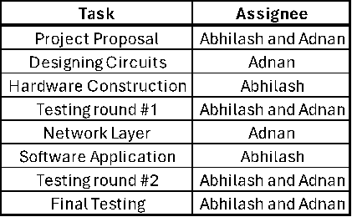
Work Distribution

Slide 10
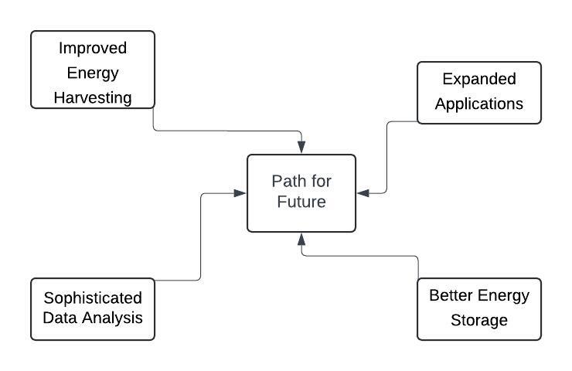
path for future

Slide 11
Concluding Thoughts
The NerG project aims to gain skills and knowledge in energy collection by providing an informative experience, despite potential challenges.
We seek to present a proof of concept showcasing the potential of underutilized energy sources, advancing sustainable energy solutions.
By setting attainable objectives and using accessible resources, we will demonstrate that minor efforts can yield significant outcomes within a broader framework.
This journey not only enhances our technical proficiency but also motivates us to continuously seek innovative solutions to global energy problems, laying the foundation for future advancements in intelligent energy systems.

Slide 12
References
Amazon.com
Paradiso, J., & Starner, T. (2005). Energy Scavenging for Mobile and Wireless Electronics. IEEE Pervasive Computing, 4, 18-27.
Ottman, G., Hoffman, H., Bhatt, A., & Lesieutre, G. (2002). Adaptive Piezoelectric Energy Harvesting Circuit for Wireless Remote Power Supply. IEEE Transactions on Power Electronics, 17( 5), 669-676.
Yuan, R., Cheng, S., & Arnold, D. (2013). An Energy Harvesting System for Passively Generating Power from Human Activities. Journal of Micromechanics and Microengineering, 23, 9 pages.
Litwhiler, D., & Gavigan, T. (2008). Energy Harvesting: Measurement and Analysis of Swing Doors. Journal of Engineering Technology, 25(2), 26-31.
Yildiz, F. (2011). Energy Harvesting from Passive Human Power. Journal of Applied Science and Engineering Technology, i, 5-16.

Slide 13
Thank You

